Slide 1
HitM: High-Throughput ReRAM-based PIM for Multi-Modal Neural Networks
Bing Li, Ying Wang , Yiran Chen
Department of Electrical & Computer Engineering, Duke University, Durham, NC, USA 2020, ICCAD

Slide 2
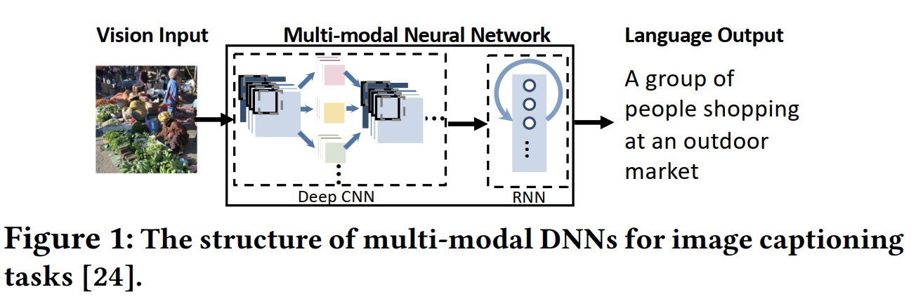
Scenario
Multi-modal NNs on ReRAM-based accelerator:
Multi-modal NNs: a fusion of heterogeneous NNS

Slide 3
Scenario
Multi-modal NNs on ReRAM-based accelerator:
Challenges: Throughput optimization strategies are different for Linear layer and Conv layer
CNNs: filter replication
RNNs: model compression

Slide 4
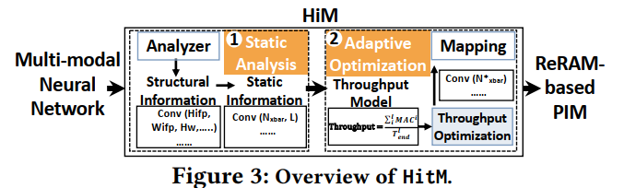
Overview of HitM
Two stages:
Static analysis
Adaptive optimization

Slide 5
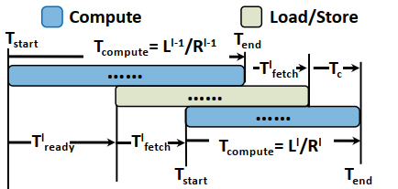


Throughput estimation model
1. Computing latency of a Conv layer: $L=T_{a}×B_{ifp}×H_{ofp}×W_{ofp}$ where $T_{a}$- computing cycle period; $B$-bit-width precision; $ifp/ofp$- input/output feature map
2. Pipelined execution time:
$T_{start}^{l}=T_{start}^{l−1}+t_{ready}^{l}+t_{fetch}^{l}$
$T_{end}^{l}=\max\left(T_{end}^{l−1}+t_{fetch}^{l}+t_{c},T_{start}^{l}+L^{l}/R^{l}\right)$
$T_{ready}$: the first output is generated
$T_{fetch}$: load from $l−1$’s OR to $l$’s IR
$T_{c}$: compute time after all inputs are loaded

Slide 6

Throughput estimation model
3. Throughput: $Throughput=\frac{\sum_{i=1}^{l}{MAC^{i}}}{T_{end}^{l}}$

Slide 7

Problem formulation
Bin-packing problem
Goal: Maximizing $Throughput$
Constraint: $s.t. \sum_{i=0}^{l}{N_{xbar}^{i}×R^{l}}≤ℕ_{PIM}^{′}$
Solution: dynamic programming

Slide 8
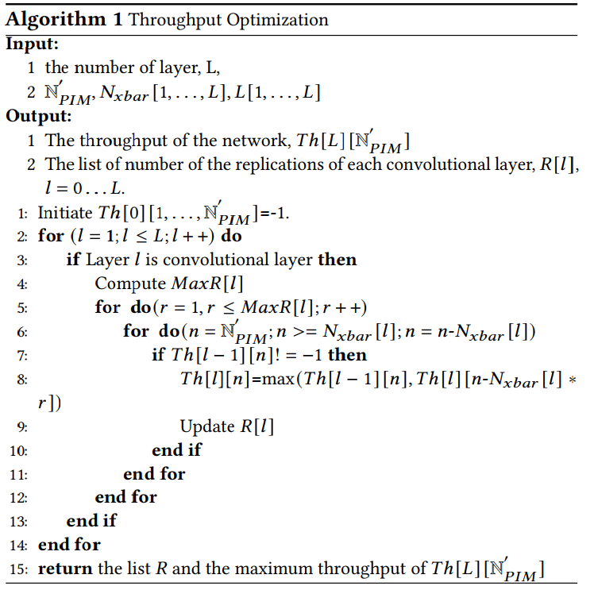
Algorithm

Slide 9
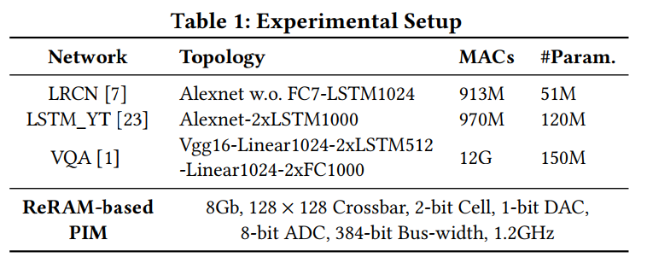
Evaluations
Benchmarks:
Simulator: event-driven

Slide 10
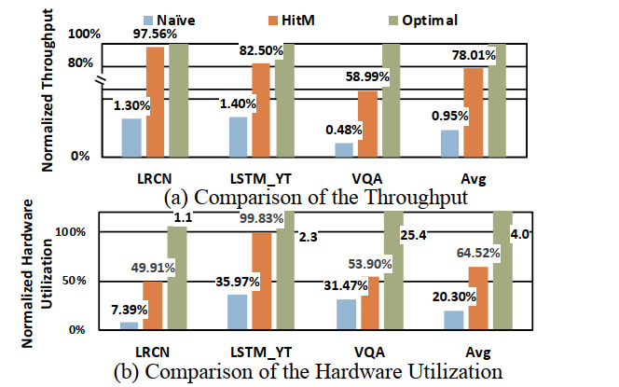
Evaluations
Hardware utilization:
Naïve: without replication
Optimal: without the resource constraint

Slide 11
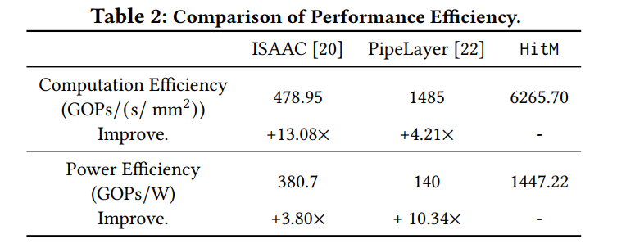
Evaluations
Compared with ISAAC/PipeLayer

